Slide 1

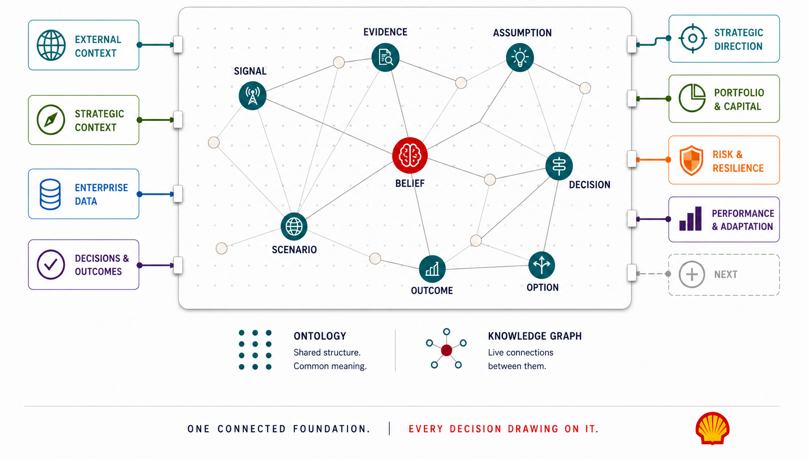
DATA, DIGITAL & AI
STRATEGY FABRIC
The decision intelligence layer
SHAPE
CONNECT
ACCELERATE
Abhishek Dangarikar, Abhishek Mishra, Subhrajit Dey
SCA Global Team F2F 2026 | 7–8 September
ONE ORGANISATIONAL MEMORY. CONTEXT THAT CARRIES.
AMBITION TO ACTION
THE AMBITION: One shared architecture for Shell’s knowledge, assumptions, evidences, decisions and outcomes - connected once, reused across capabilities and use cases
WHAT IT SOLVES: Context sits across models, plans and commitments without persistent connections. When something change – internally or externally, the implications are hard to trace.
WHAT WE ARE DOING: Building the ontology and knowledge graph through Strategy & Capital Allocation use cases. So each new query reuses the same foundation rather than rebuilding it.
Shape. Connect. Accelerate.
September 7–8, 2026
Notes:
Swap DIL and SF
One shared structure for what we know — and what we're only assuming.
Repurpose using Org memory, and contextual decisions
One connected Fabric, driving every decision.
PROPOSITION – change

